Slide 1
CLIENT SERVER IMPLEMENTATION USING PYTHON IN DOCKER CONTAINER
TEAM:
VENKATAPATHI AMULYA 13241A05N8
SREERAM MOUNIKA 13241A05M2
VANGALA USHASREE 13241A05N4
AISHWARYA VARALA 13241A0505
GUIDED BY:
Prof.Dr.G.R.Sakthidharan
MENTORS:
Asst.Prof Y.Manoj Kumar
Asst.Prof K.Adhilaxmi
Asst.Prof Ch.Shruthi

Slide 2

DEPARTMENT OF COMPUTER SCIENCE AND ENGINEERING

Slide 3
AIM OF THE PROJECT
To implement client server architecture using python in docker container.

Slide 4
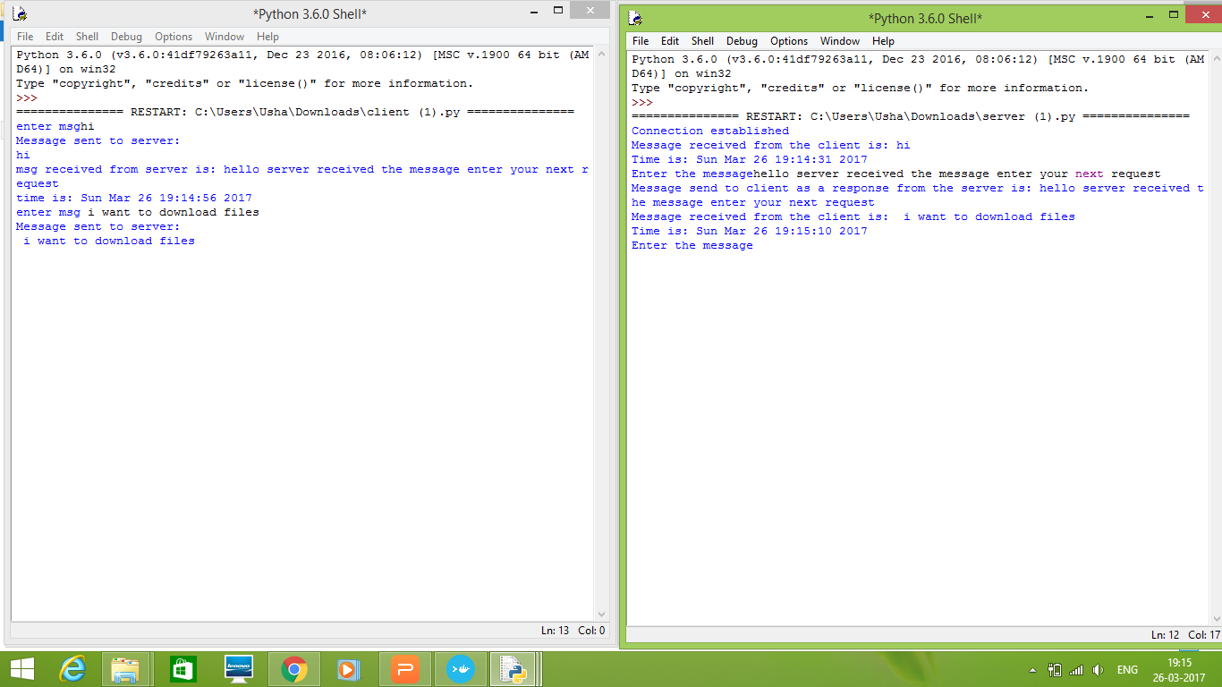
OUTPUT OF CLIENT/SERVER IN PYTHON

Slide 5
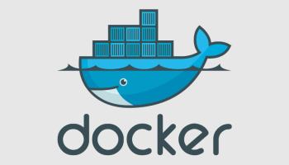
WHAT IS A DOCKER?
Docker : Docker allows you to package an application with all of its dependencies into a complete file system that contains everything it needs to run: code, runtime, system tools, system libraries – anything you can install on a server. This guarantees that it will always run the same, regardless of the environment it is running in.
It is a latest technology released in the year 2013.

Slide 6
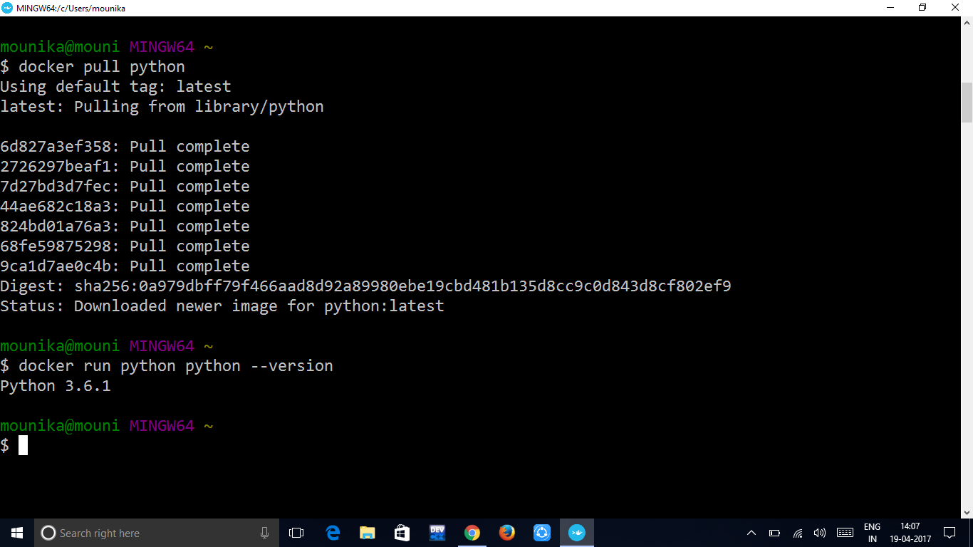
PULLING PYTHON IMAGE

Slide 7
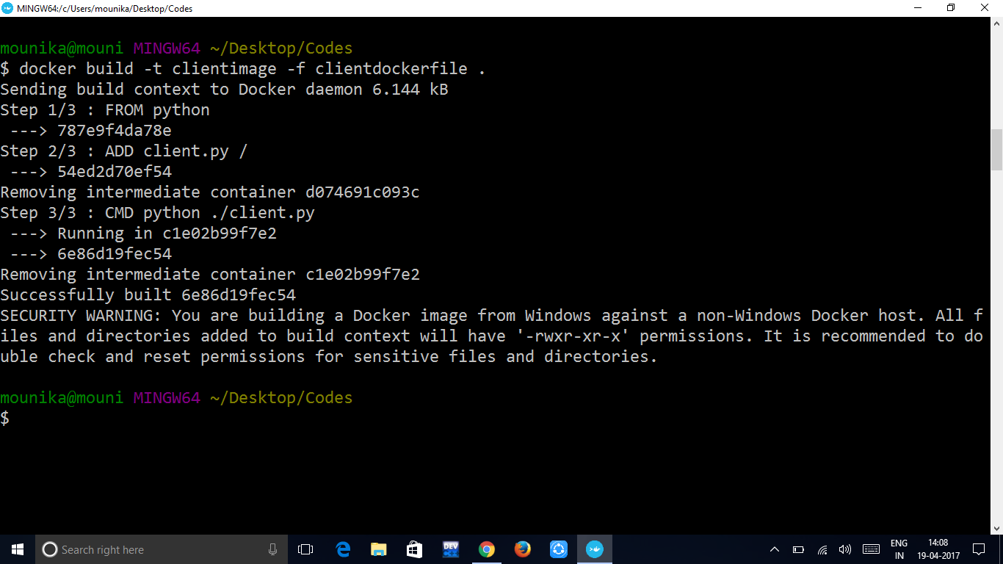
BUILDING AN IMAGE

Slide 8

BUILDING SERVER IMAGE:

Slide 9
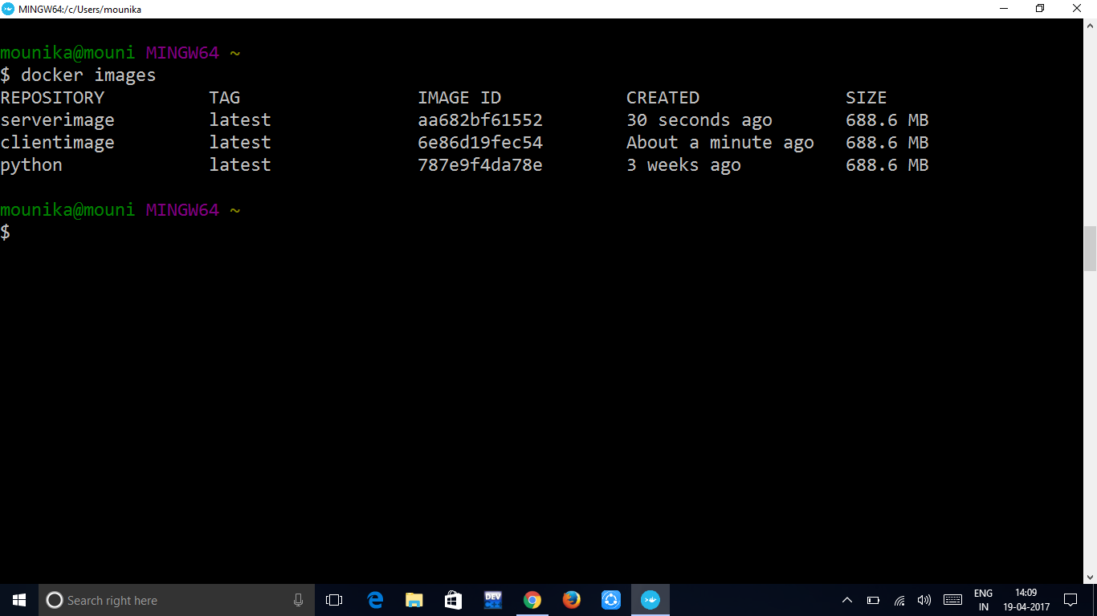
CHECKING WHETHER DOCKER IMAGE IS CREATED OR NOT USING “docker images” COMMAND

Slide 10
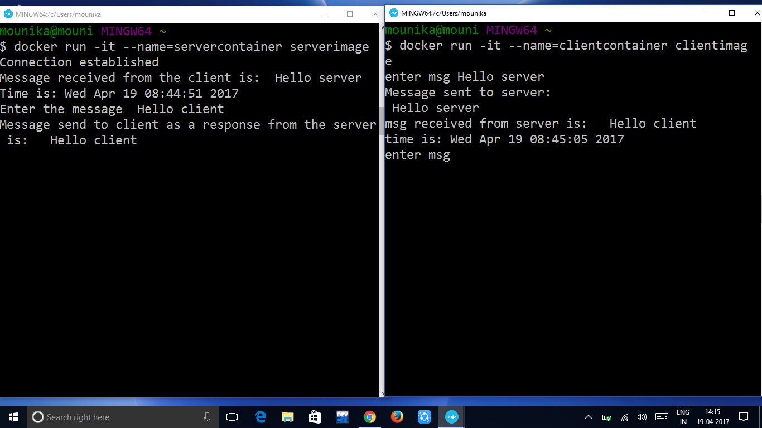
RUNNING A CONTAINER

Slide 11
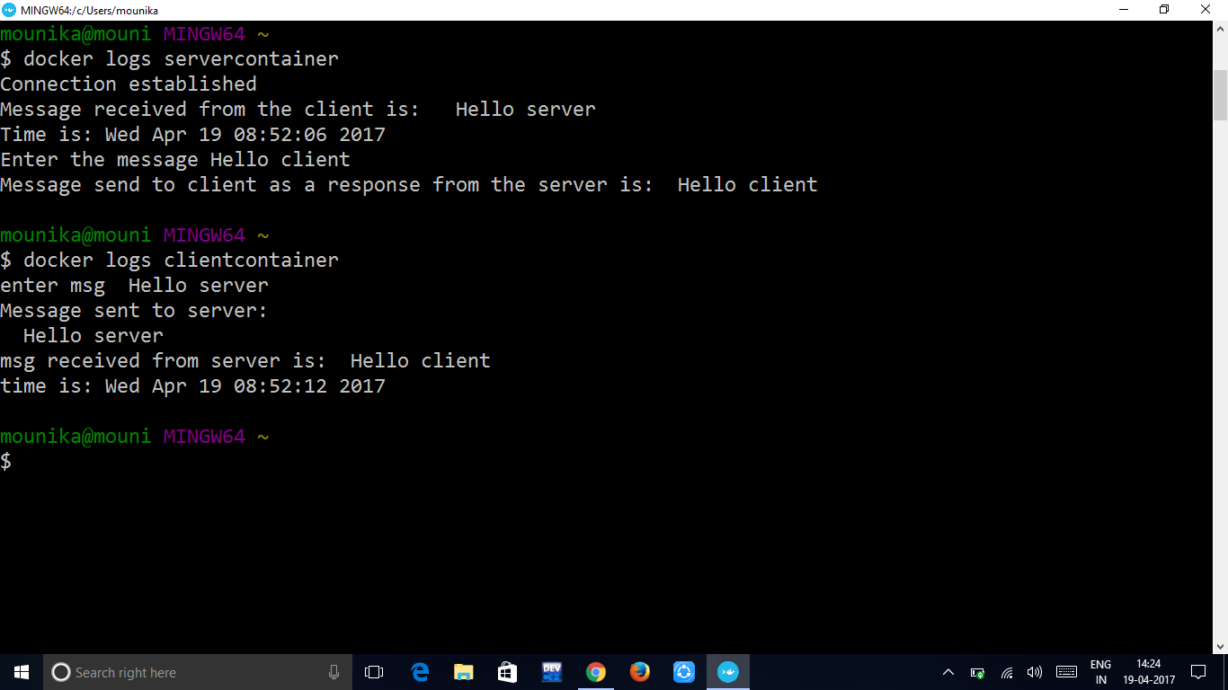
DOCKER LOGS

